Slide 1
CS-595 Software Security Paper Presentation
Presented by :
Lavanya Juvvala A20442790

Slide 2
Paper Title and Authors
Discovering and Understanding the Security Hazards in the Interactions between IoT Devices, Mobile Apps, and Clouds on Smart Home Platforms
Authors:
Wei Zhou, Yan Jia, Yao Yao, Lipeng Zhu,
Le Guan,Yuhang Mao ,Peng Liu, Yuqing Zhang

Slide 3
INTRODUCTION
ATTACKS
01
04
METHODOLOGY
DEFENSES
02
05
FINDINGS
CONCLUSION
03
06
Background, Overview of Interactions in Smart Home platforms
Flaw Exploitation, Remote Device substitution, Remote Device Hijacking
Threat Model, Prerequisites, Analysis, Phantom Devices
Mitigation Techniques
Design Flaws
Related Works

Slide 4
01
Introduction

Slide 5
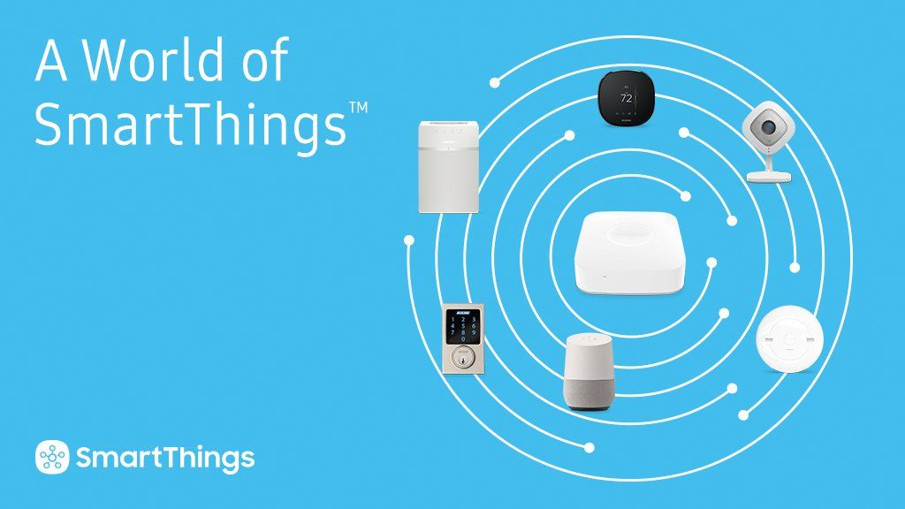
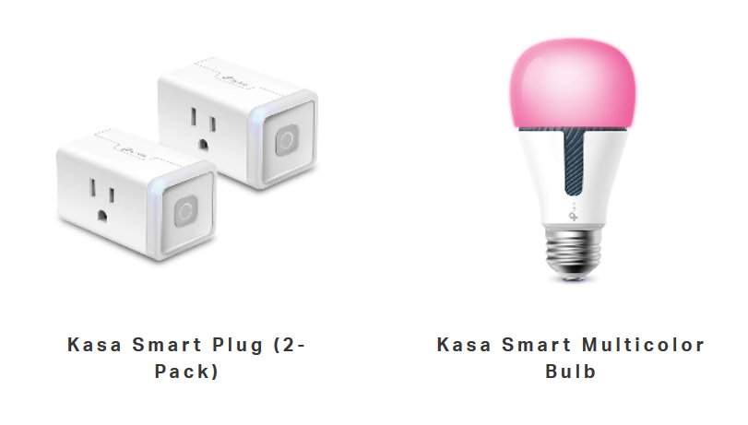
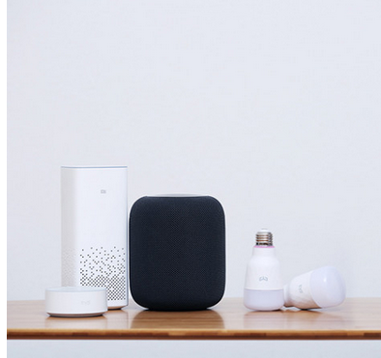
INTRODUCTION
Analysis of Five widely used smart home platforms
Samsung Smart Things
TP-Link Kasa
Xiaomi Mijia
Ali Alink
JD Joylink
Focus of existing studies
Individual parts of smart home platforms are the central points of discussion
Classic Security issues are pointed out but nothing about entity-entity interactions
Discovering and understanding the security hazards in smart home platforms
MITM attacks
State Transitions
Phantom devices
Main Contributions/ Insights
Guarding the validity of State Transitions
Unexpected state transitions
Authorization checks

Slide 6
INTRODUCTION
SECURITY
Discovery of new hazards
Replacing a real device with a phantom device
Remote takeover of the device
Unbinding an authorized user
Stealing the identity of real device
Misuse of phantom device to steal information
Background Terminology
Device ID
Identity Information
Legitimacy Information
Phantom Devices

Slide 7
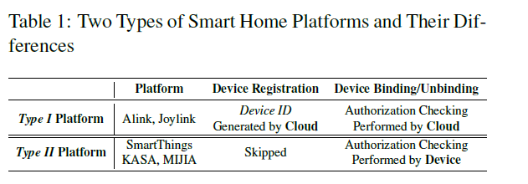
INTRODUCTION
Overview of Smart Home Platforms
Device Identify Management
IoT devices
Mobile application
Interactions on Smart Home Platforms
Depending on how device ID of device is generated, smart home platforms are classified into two types:
Type I and Type II

Slide 8
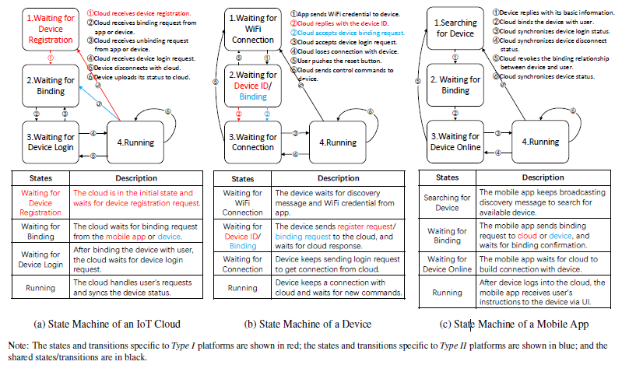
INTRODUCTION
State Transitions
Lifecycle of IoT devices
Device Discovery
Wi-Fi Provisioning
Device Registration
Device Binding
Device Login
Device in Use
Device Unbinding and device reset

Slide 9
02
Methodology

Slide 10
METHODOLOGY
Threat Model
Threat model seeks to exploit the design flaws in interactions of the three entities.
The adversary’s goal is to take control of cloud connected devices and monitor /manipulate the data generated by the device.
In Type II platforms, we assume that the adversary has local access to victim device.
In Type I platforms, no such assumptions are made.
Prerequisites
Public Information- Easiest to obtain. Items in this category are publicly available. Example: Device model and device chip id (CID)
Guessable Information- Items which can be guessed by Brute-force. Example: MAC addresses
Hard-coded information- It is unpredictable, immutable, inherent to a device. Example: Long device ID embedded in device hardware.

Slide 11
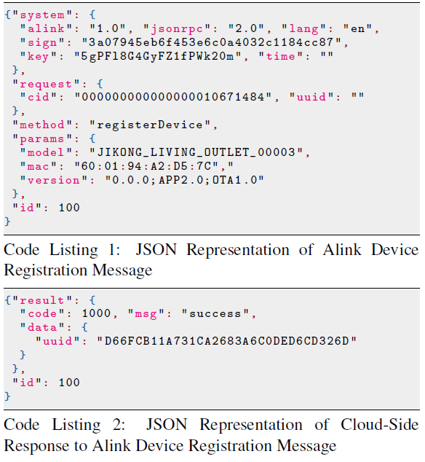
METHODOLOGY
Uses of the discovered exploits
Ownership of device can be misused
Smart home rentals are at high risk
Analysis
Deciphering the communication
Cloud-App Communication
Device-App Communication
Device-Cloud Communication
Understanding the Interacting Messages

Slide 12
METHODOLOGY
Phantom Devices
Checking if state machine is maintained
Checking if legitimate 3-tuple state combination is maintained
Verifying if proper authorization checks are performed
Need: Send JSON messages to receiving entities by mimicking the real device
Construction of Phantom Devices
Reusing the communication logic provided by open-source device SDKs.
Example: Samsung, JD, Ali
Reverse engineering the proprietary SDKs.
Example: Xiaomi, TP-Link
Uses of phantom Devices:
Trigger unexpected state Transitions
Helps understand internal logic of IoT cloud

Slide 13
03
Findings

Slide 14
FINDINGS
F1: Insufficient State Guard
F3: Unauthorized Device Login
F2: Illegal State Combination
F4: Unauthorized Device Unbinding
Design Flaws

Slide 15
FINDINGS
F 1: Insufficient State Guard
In the state machine of an IoT cloud , when the cloud is working
in state 4 it should only accept status upload requests or device unbinding requests
F1.1: Type I platforms
Device ID is returned when a registration request is sent
F1.2: Type II platforms
Binding Request is accepted to bind attacker’s account to victim device
F1.3: Accepts device login requests even in state 4
F 2: Illegal State Combination
Three entities tsay in unexpected and illegal state combinations.
Root Cause: Flawed Synchronization among them
F 3: Unauthorized Device Login
Allowing login requests from devices that are not bound to owner account
F 4: Unauthorized Device Unbinding
Only the user who holds an account bound to device can unbind the device

Slide 16
04
Attacks

Slide 17
ATTACKS
Obtaining Device Identity and Legitimate Information
Building Phantom device
Network Configuration
Experimental Setup

Slide 18
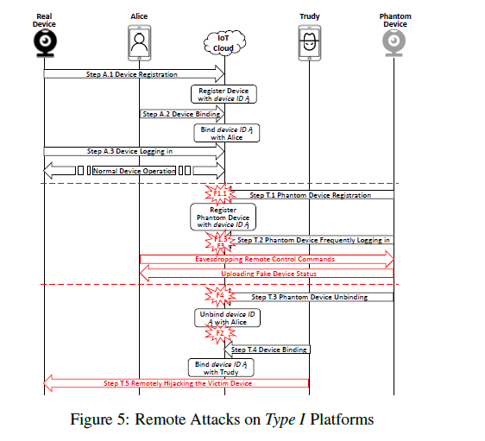
Remote Device Substitution
Attack Overflow (Type I)
Consequences:
1. Privacy Breaches: All control commands from the victim are exposed to the attacker leading to privacy breach.
2. Falsified Data: Sensor readings are sent from phantom device so they can be manipulated to deceive or mislead the victim.
3. Stealthiness Analysis:
Victim always sees the device to be online so it is very stealthy attack and the victim rarely gets suspicious.

Slide 19
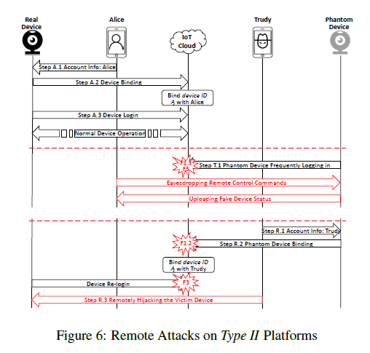
Remote Device Substitution
Attack Overflow (Type II)
Consequences:
1. Privacy Breaches: All control commands from the victim are exposed to the attacker leading to privacy breach.
2. Falsified Data: Sensor readings are sent from phantom device so they can be manipulated to deceive or mislead the victim.
3. Stealthiness Analysis:
Victim always sees the device to be online so it is very stealthy attack and the victim rarely gets suspicious.

Slide 20
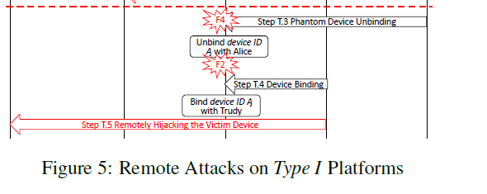
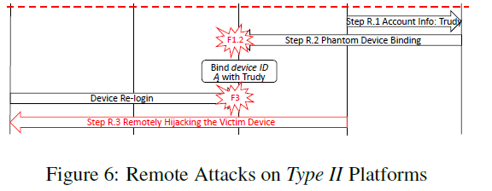
Remote Device Hijacking
Attack Overflow (Type I)
Attack Overflow (Type II)
Consequences:
1. Attacker can bind their account to victim’s device
2. Attacker can send remote commands to control victim’s device
3. Trace back to the attacker is very difficult

Slide 21
Other Security Hazards
1. Remote Device DoS
If an attacker can unbind a target device from its legitimate user, the target device cannot be operated anymore, essentially leading to device denial of service (DoS) attack.
2. Illegal Device Occupation
Although a device may be shared with multiple users, only one user account is allowed to be bound to a smart home
device.
If the attacker can predict the device IDs of unsold devices and use phantom devices to bind them with valid user accounts, these devices cannot be bound again after being sold.
3. Firmware Theft
By forging different kinds of phantom devices, the attacker can issue OTA update requests in bulk, and thus
he/she can harvest hundreds of firmware images in seconds.

Slide 22
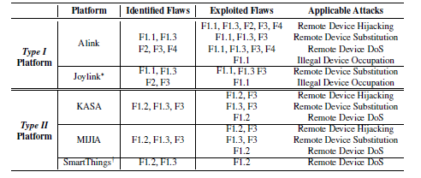
ATTACKS

Slide 23
05
Defense

Slide 24
Defense
Mitigation Techniques
Strict Device Authentication
IoT cloud should always examine the client certificate before accepting device request. On the cloud side,the cloud should always check whether the random number matches the other identity or legitimacy information.
Comprehensive Authorization Checking
IoT clouds should enforce strict authorization checking of device-side commands
Enforcing the validity of State Transitions
In order to prevent the attacker from exploiting unexpected state transitions, smart home platforms should identify and formulate every legitimate interaction request as a 3-tuple in the form of (sender entity & its state, the request message, receiver entity & its state).

Slide 25
06
Conclusion

Slide 26
Conclusion and Related Work
Device Security.
Device security research emphasizes the vulnerabilities of individual devices. Ling et al. [1] studied a smart plug system and revealed a weak authentication vulnerability. After dissecting the behavior of several IoT devices such as Phillips Hue light bulbs and Nest smoke detectors, Notra et al. [2] revealed that basic security mechanisms such as encryption, authentication and integrity checking are absent in these devices. Several currently available smart hubs were investigated in [3] , and numerous security flaws were identified.
In contrast to analyzing individual devices, this study analyzes the complex interactions among the three entities engaged in a smart home platform.
Communication Security.
Communication security research emphasizes the security and privacy issues in smart home communication protocols such as BLE, ZigBee, and Z-Wave [4].
Agosta et al. [5] approached the security and privacy problems involved in the key derivation algorithm adopted by the widespread Z-Wave home automation protocol.
Ronen et al. [6] described a worm attack
which has the potential of massive spread by exploiting an implementation bug in the ZigBee Light Link protocol.
Researchers also demonstrated that attackers can infer private in-home activities by analyzing encrypted traffic from smart home devices.
IoT Application Security.
Recently, increasing numbers of researchers have paid their attention to smart home platforms, but they usually focus only on in-cloud IoT applications (i.e. home automation applications). For instance, Fernandes et al. [7] revealed that the capabilities implemented in the SmartThings IoT application programming framework are too coarse-grained, which allows malicious third-party IoT applications to compromise the SmartThings platform. Celik et al. [8] proposed SAINT, a static taint analysis tool to find sensitive data flows in IoT applications. The same authors further studied whether an IoT application and its environment adhere to functional safety properties. They found that 9 out of 65 SmartThings apps violate 10 out of 35 properties [9].

Slide 27
REFERENCES
[1] Zhen Ling, Junzhou Luo, Yiling Xu, Chao Gao, Kui Wu, and Xinwen Fu.
Security Vulnerabilities of Internet of Things: A Case Study of the Smart Plug System. IEEE Internet of Things Journal, PP(99):1–1, 2017.
[2] S Notra, M Siddiqi, H. H Gharakheili, and V Sivaraman.
An experimental study of security and privacy risks with emerging household appliances. In Communications and Network Security, pages 79–84, 2014.
[3] Steven A. Christiaens. Evaluating the Security of Smart Home Hubs. Master’s thesis, Brigham Young University, 2015.
[4] B.Fouladi and S.Ghanoun. Honey, I’m Home!!, Hacking Zwave Home Automation Systems. In Black Hat USA, 2013.
[5] Giovanni Agosta, Alessio Antonini, Alessandro Barenghi, Dario Galeri, and Gerardo Pelosi. Cyber-security analysis and evaluation for smart home management solutions. In International Carnahan Conference on Security Technology, pages 1–6, 2016.
[6] Eyal Ronen, Adi Shamir, Achi-OrWeingarten, and Colin Oâ˘A ´ ZFlynn.
IoT goes nuclear: Creating a ZigBee chain reaction. In 2017 IEEE Symposium on Security and Privacy, pages 195–212. IEEE, 2017.
[7] Earlence Fernandes, Jaeyeon Jung, and Atul Prakash.
Security analysis of emerging smart home applications. In Security and Privacy, pages 636–654, 2016.
[8] Z Berkay Celik, Leonardo Babun, Amit Kumar Sikder, Hidayet Aksu,Gang Tan, Patrick McDaniel, and A Selcuk Uluagac.
Sensitive information tracking in commodity IoT. In Proceedings of Usenix Security Symposium, pages 1687–1704, 2018.
[9] Z Berkay Celik, Patrick McDaniel, and Gang Tan.
SOTERIA: Automated IoT safety and security analysis. In 2018 Usenix Annual Technical Conference, pages 147–158, 2018.

Slide 28

Thank you!

